Slide 1
UNIT 7
SOFTWARE MAINTENANCE AND EVOLUTION
Hours: 6 Hrs
Presented by
Er.Harendra Bikram Shah (Lecturer)
Department of BCA NAST

Slide 2
OUTLINES
Software Maintenance
Evolving Nature of Software,
Types of software maintenance: corrective, adaptive, perfective, preventive.
Re-engineering and Configuration Management
Process of software re-engineering and version control.
Importance of configuration management in large-scale software systems.

Slide 3
SOFTWARE MAINTENANCE
Refers to the process of modifying and updating a software system after it has been delivered to the customer.
This involves fixing bugs, adding new features, and adapting to new hardware or software environments.
Key Aspects of Software Maintenance
Bug Fixing:
Enhancements:
Performance Optimization:
Porting and Migration:
Re-Engineering:
Documentation:

Slide 4
SOFTWARE MAINTENANCE
Need for Maintenance
Correct faults.
Improve the design.
Implement enhancements.
Migrate legacy software.
Run the code fast
Several Types /Categories of Software Maintenance
Corrective Maintenance:
Patching:
Adaptive Maintenance:
Perfective Maintenance:
Preventive Maintenance:

Slide 5
SOFTWARE MAINTENANCE
Challenges in Software Maintenance
Lack of documentation:
Legacy code:
Complexity:
Changing requirements:
Interoperability issues:
High-Cost:

Slide 6
SOFTWARE MAINTENANCE
Advantages of Software Maintenance
Improved Software Quality:
Enhanced Security:
Increased User Satisfaction:
Extended Software Life:
Cost Savings:
Better Alignment with business goals:
Competitive Advantage:
Compliance with Regulations:
Reduced Downtime:
Improved Scalability:
Disadvantages of Software Maintenance
Cost:
Schedule disruptions:
Complexity:
Risk of introducing new bugs:
User resistance:
Compatibility issues:
Lack of documentation:
Skill gaps:

Slide 7
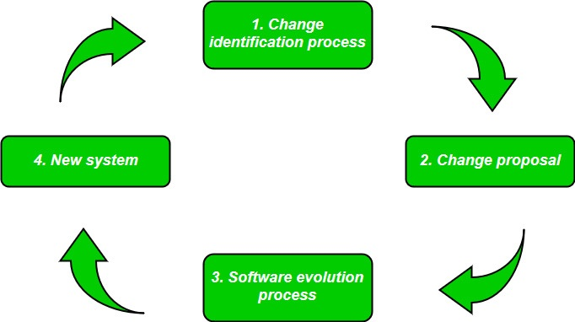
SOFTWARE EVOLUTION
Refers to the process of developing software initially, and then timely updating it for various reasons.

Slide 8
SOFTWARE EVOLUTION
Necessity of Software Evolution
Change in requirement with time:
Environment change:
Errors and bugs:
Security risks:
For having new functionality and features:

Slide 9
LAWS USED FOR SOFTWARE EVOLUTION
1. Law of Continuing Change
Any software system that represents some real-world reality undergoes continuous change or become progressively less useful in that environment.
2. Law of Increasing Complexity
As an evolving program changes, its structure becomes more complex unless effective efforts are made to avoid this phenomenon.
3. Law of Conservation of Organization Stability
The rate of development of the program is approximately constant and independent of the resource devoted to system development.
4. Law of Conservation of Familiarity
This law states that during the active lifetime of the program, changes made in the successive release are almost constant.

Slide 10
SOFTWARE RE-ENGINEERING
Process of analyzing, designing, and modifying existing software systems to improve their quality, performance, and maintainability.
Objective of Re-engineering
To describe a cost-effective option for system evolution.
To describe the activities involved in the software maintenance process
To distinguish between software and data re-engineering and to explain the problems of data re-engineering.

Slide 11
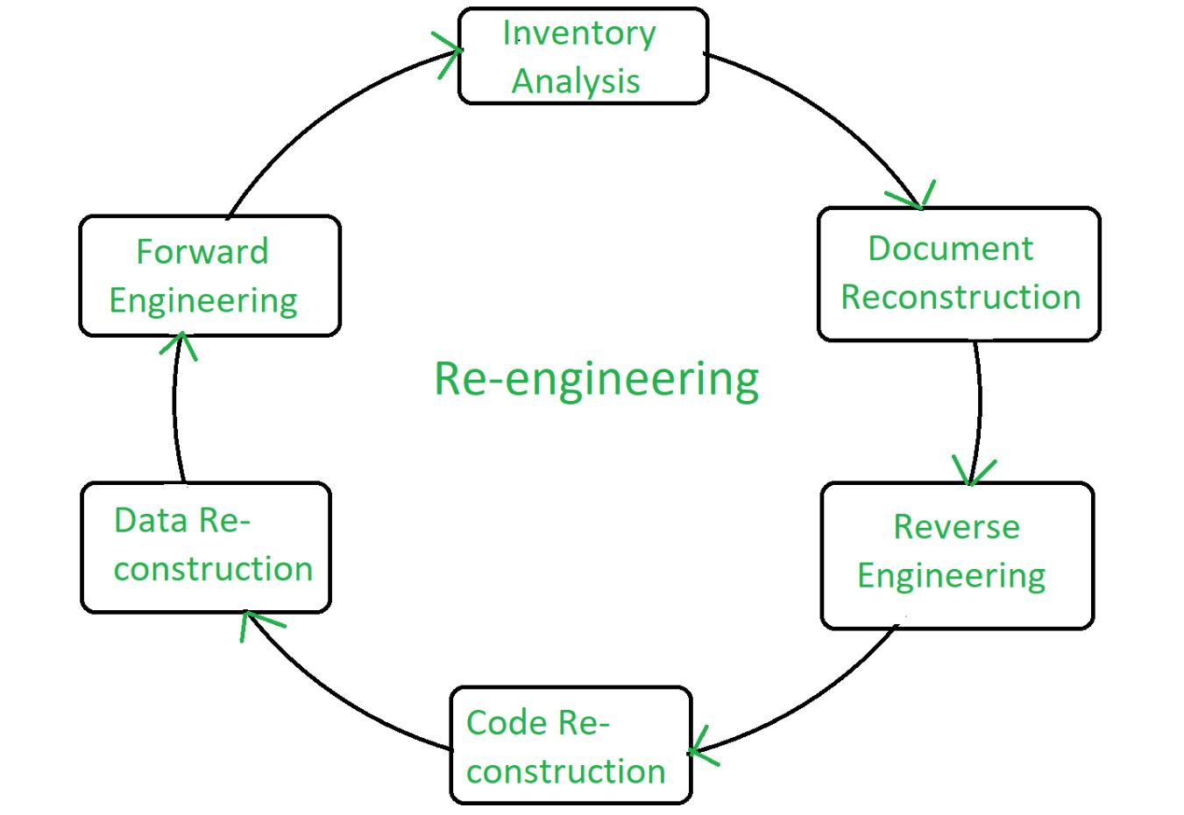
STEPS IN SOFTWARE RE-ENGINEERING

Slide 12
WHY SOFTWARE RE-ENGINEERING
To improve the software’s performance and scalability:
To add new features:
To support new platforms:
To improve maintainability:
To meet new regulations and compliance:
Improving software quality:
Updating technology:
Enhancing functionality:
Resolving issues:

Slide 13
ADVANTAGES OF RE-ENGINEERING
DISADVANTAGES OF RE-ENGINEERING
High costs:
Disruption to business operations:
Resistance to change:
Risk of failure:
Lack of employee involvement:
Difficulty in measuring success:
Difficulty in maintaining continuity:
Reduced Risk:
Reduced Cost:
Better use of Existing Staff:
Improved efficiency:
Increased flexibility:
Better customer service:

Slide 14
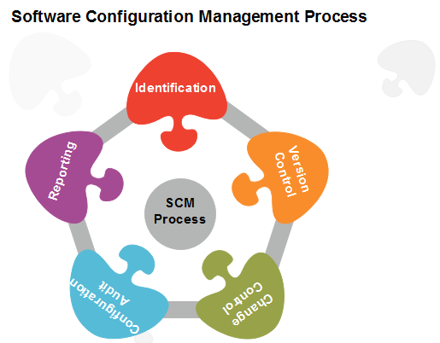
Software Configuration Management(SCM)
It is a process to systematically manage, organize, and control the changes in the documents, codes, and other entities during the Software Development Life Cycle.
Processes/Task involved in SCM
1. Identification and Establishment
2. Version control
3. Change control
4. Configuration auditing
5. Reporting

Slide 15
Importance of Software Configuration Management
Effective Bug Tracking:
Continuous Deployment and Integration:
Risk management:
Support for Big Projects:
Reproducibility:
Parallel Development:
Need for System configuration management
Replicability:
Identification of Configuration:
Effective Process of Development:

Slide 16
Key objectives of SCM
Control the evolution of software systems:
Enable collaboration and coordination:
Provide version control:
Facilitate replication and distribution:
SCM is a critical component of software Development.
The main advantages of SCM
Improved productivity and efficiency
Reduced risk of errors and defects
Increased collaboration and communication among team members
Improved quality and stability of software systems
The main disadvantages of SCM
Increased complexity and overhead
Difficulty in managing dependencies and ensuring that all changes are properly integrated.
Potential for conflicts and delays.

Slide 17
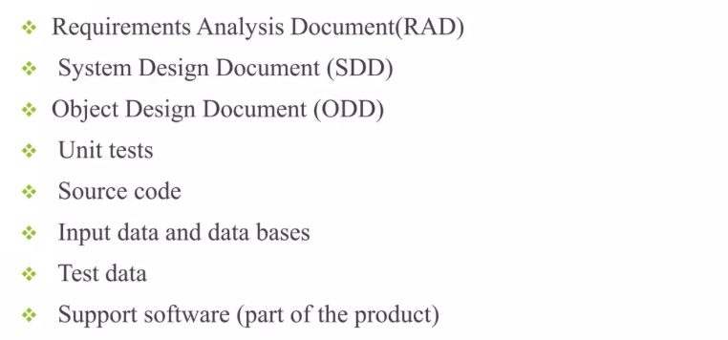
Software Configuration Items
Software Configuration Item is information that is created as part of the software engineering process.

Slide 18
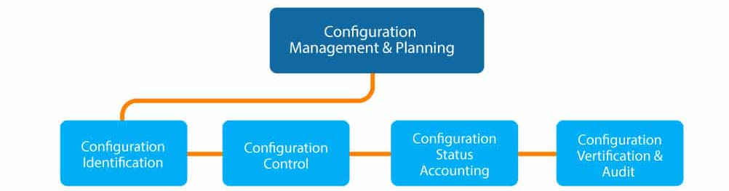
Configuration Management
Art of identifying organizing and controlling Modifications to the software being built by a programming team.
The goal is to maximize productivity by minimizing mistakes

Slide 19
Configuration Management Activities
1. Change Management
Ensure that all changes to a system are controlled, evaluated, and tracked to maintain stability and traceability.
Activities:
Recording change requests and assigning priorities.
Impact analysis to assess potential consequences of changes.
Approving or rejecting changes based on the analysis.
Implementing approved changes while minimizing disruptions.
Maintaining documentation to track all changes and their effects.
2. Version Management
Control versions of software artifacts (e.g., source code, documentation) to avoid conflicts and ensure consistency.
Activities:
Assigning version identifiers to each release or update.
Maintaining a repository to store and track versions of files.
Supporting branching and merging for parallel development efforts.
Providing version history to enable rollback if necessary.

Slide 20
Configuration Management Activities
3. System Building
Automate the process of compiling, linking, and integrating system components to create a working system.
Activities:
Defining build scripts and tools to automate the build process.
Integrating modules and ensuring compatibility between components.
Running automated tests during the build process to verify system functionality.
Detecting and resolving build errors early in development.
4. System Release
Plan, package, and deliver a stable system version to users or customers.
Activities:
Preparing release documentation, including release notes and user guides.
Creating installation packages or deploying the system to production.
Ensuring the system meets quality assurance standards.
Managing the release schedule and coordinating with stakeholders.

Slide 21
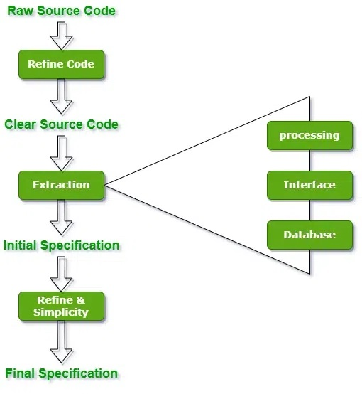
Reverse Engineering
process of recovering the design, requirement specifications, and functions of a product from an analysis of its code.

Slide 22
VERSION CONTROL
tool that helps track and manage changes to a project's codebase over time.
It allows multiple developers to work on the same project simultaneously without conflicts, maintains a history of all changes, and enables easy rollback to previous versions if needed.
VC ensures collaboration, code integrity, and efficient management of software development.
Importance of Version Control
Track Changes Over Time:
Collaboration:
Code History and Audit Trails:
Backup and Recovery:
Branching and Merging:
Popular Version Control Systems
1. Git
It is the most widely used Distributed Version Control System, developed by Linus Torvalds in 2005 for managing the Linux kernel.
2. Subversion (SVN)
Subversion is a popular centralized version control system
3. Mercurial
Mercurial is another distributed version control system similar to Git but with a simpler interface.

Slide 23
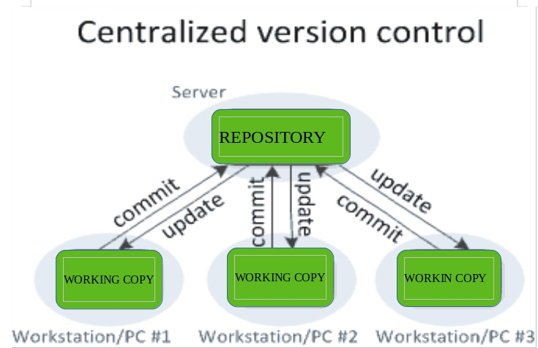
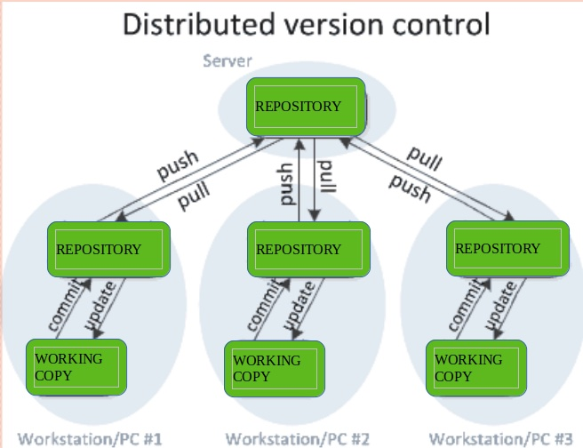
VERSION CONTROL
Types of Version Control Systems

Slide 24
BENEFITS OF THE VERSION CONTROL SYSTEM
Enhanced Collaboration:
Track Changes:
Branching & Merging:
Backup & Recovery:
Improved Code Quality:
Efficient Remote Collaboration:
Continuous Integration:
Better Project Management:
Security:
USE OF VERSION CONTROL SYSTEM
Tracking Changes:
Collaboration:
Conflict Resolution:
Backup and Recovery:
Testing Without Risk:
Continuous Integration:

Slide 25
End of The Unit

Slide 26
End of Syllabus

Slide 27
THANK YOU

